Slide 1


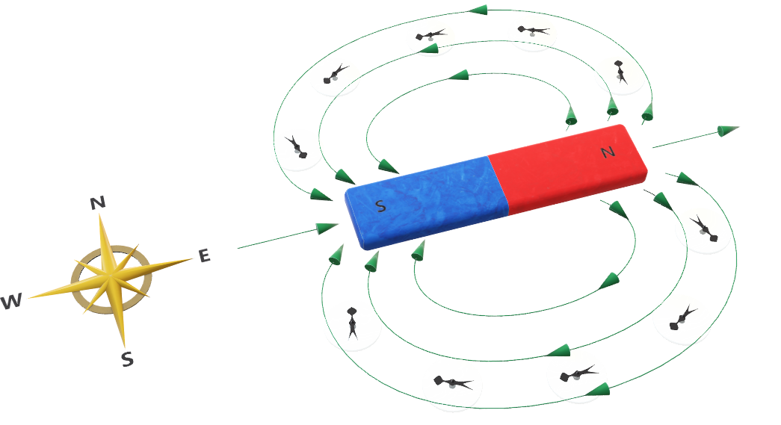
Duration: 60 min
High School
Grade: 11
CCSS, NGSS
Magnetism:
Magnetic Fields
Author: Michael Carter
Click on the model to interact

Slide 2

Lesson overview
Magnets are common items in our daily lives. Playing around with some magnets, we can see some basic features:
Magnets exert force on each other, as well as on certain metals.
This force is strongest when they are touching, but also acts at a distance.
Magnets can either attract or repel each other, depending on how they are held.
Learning objectives
Know how to determine the direction of a permanent magnetic field.
Know that a current-carrying wire creates a magnetic field.
Know how to determine the direction of the magnetic field produced by a current-carrying wire.
Keywords
Magnetic Domains, Magnetic Poles, Magnetism, Right-Hand Rule

Slide 3
Standards
Common Core CCSS ELA-Literacy RST.9-10.8
NGSS Students who demonstrate understanding can:
Assess the extent to which the reasoning and evidence in a text support the author’s claim or a recommendation for solving a scientific or technical problem.
HS-PS4-1
Use mathematical representations to support a claim regarding relationships among the frequency, wavelength, and speed of waves traveling in various media.
RST.11-12.1
Cite specific textual evidence to support analysis of science and technical texts, attending to important distinctions the author makes and to any gaps or inconsistencies in the account.
HS-PS4-3
Evaluate the claims, evidence, and reasoning behind the idea that electromagnetic radiation can be described either by a wave model or a particle model, and that for some situations one model is more useful than the other.
RST.11-12.7
Integrate and evaluate multiple sources of information presented in diverse formats and media (e.g., quantitative data, video, multimedia) in order to address a question or solve a problem.
HS-PS4-4
Evaluate the validity and reliability of claims in published materials of the effects that different frequencies of electromagnetic radiation have when absorbed by matter.
RST.11-12.8
Evaluate the hypotheses, data, analysis, and conclusions in a science or technical text, verifying the data when possible and corroborating or challenging conclusions with other sources of information.
HS-PS4-5
Communicate technical information about how some technological devices use the principles of wave behavior and wave interactions with matter to transmit and capture information and energy.
WHST.9-12.2
Write informative/explanatory texts, including the narration of historical events, scientific procedures/ experiments, or technical processes.
Science and Engineering Practices
Asking Questions and Defining Problems
Using Mathematics and Computational Thinking
Engaging in Argument from Evidence
Obtaining, Evaluating, and Communicating Information
Disciplinary Core Ideas
PS3.D Energy in Chemical Processes
PS4.A Wave Properties
WHST.11-12.8
Gather relevant information from multiple authoritative print and digital sources, using advanced searches effectively; assess the strengths and limitations of each source in terms of the specific task, purpose, and audience; integrate information into the text selectively to maintain the flow of ideas, avoiding plagiarism and overreliance on any one source and following a standard format for citation.
Common Core Mathematics MP.2
PS4.B Electromagnetic Radiation
PS4.C Information Technologies and Instrumentation
Crosscutting Concepts
Cause and Effect
Systems and System Models
Stability and Change
Connections to Engineering, Technology, and Applications of Science
Interdependence of Science Engineering, and Technology
Influence of Science, Engineering, and Technology and the Natural World
Connections to the Nature of Science
Science Models, Laws, Mechanisms, and Theories Explain Natural Phenomena
Reason abstractly and quantitatively.
MP.4
Model with mathematics.
HSA-DDE.A.1
Interpret expressions that represent a quantity in terms of its context.
HSA-SSE.B.3
Choose and produce an equivalent form of an expression to reveal and explain properties of the quantity represented by the expression.
HSA-CED.A.4
Rearrange formulas to highlight a quantity of interest, using the same reasoning as in solving equations.

Slide 4
Texbook correlations
Hewitt, P.G. (2009) Conceptual Physics. Upper Saddle River, NJ: Pearson Education. Unit V – Electricity and Magnetism, 36 – Magnetism, 720-732.
Serway, R.A., & Faughn, J.S. (2009) Holt Physics. Austin, TX: Holt, Rinehart and Winston. Chapter 19 – Magnetism, Section 1 – Magnets and Magnetic Fields, 676-682.
Walter, J.S. (2014) Pearson Physics. Upper Saddle River, NJ: Pearson Education. Chapter 22 – Magnetism and Magnetic Fields, 782-815.
Nirenberg, I. (2016) CK-12 Physics - Intermediate. Palo Alto, CA: CK-12 Foundation. 18.1 Magnetic Fields

Slide 5

ENGAGE
10
min
Pair students and have them study the 3D model “Coil of Wire and Moving Magnet” in the Lifeliqe Physics library. Then, have them discuss and share their answers to the questions:
What is causing the needle to move?
Why does it move back and forth?
Post and/or pose the essential questions of the lesson:
How do you determine the direction of a permanent magnetic field?
How does a current-carrying wire create a magnetic field?
How do you determine the direction of the magnetic field produced by a current- carrying wire?
EXPLORE
Click on the model to interact
20
min
Have students read “Magnetic Fields.”
www.ck12.org/section/Magnetic-Fields-Physics-Intermediate/

Slide 6
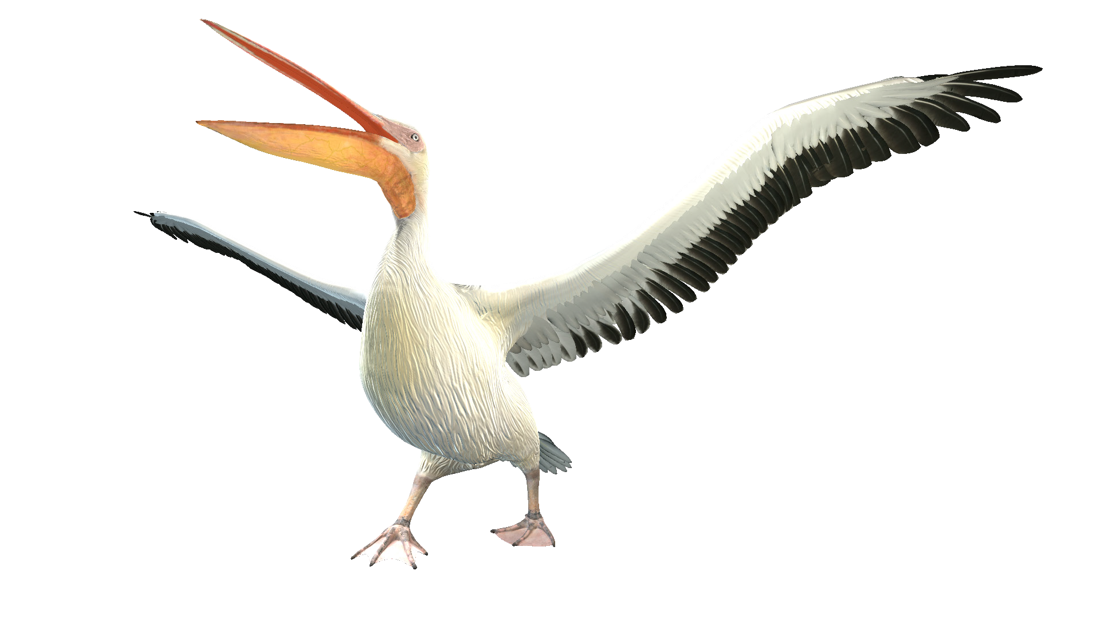
EXPLAIN
10
min
Click to open in Lifeliqe
Pair students and have them study the 3D model “Greater White Pelican” in the Lifeliqe
Animal Biology library. Then, have them discuss and share their answers to the questions:
What role do magnetic fields play in this bird’s annual migration?
How does it know which way it’s going?

Slide 7
EXTEND / ELABORATE
10
min
Have students take what they have learned and see it in authentic contexts.
Show, or have students view, “10 AWESOME MAGNET TRICKS!” www.youtube.com/watch?v=h5oXWtSMHzw
EVALUATE
10
min
“Magnetic Fields”
www.ck12.org/section/Magnetic-Fields/
Select content for this lesson plan was derived from Nirenberg, I. (2016) CK-12 Physics - Intermediate. Palo Alto, CA:
CK-12 Foundation. Except as otherwise noted, all cK-12 content (including cK-12 curriculum material) is made available to users in accordance with the Creative Commons Attribution-Non-Commercial 3.0 Unported (CC BY-NV 3.0)
License (http://creativecommons.org/licenses/by-nc/3.0/). http://www.ck12.org/saythanks.

Slide 8

Thanks for using Lifeliqe's lesson plan!
Excite your students in learning science with 1,000+ more 3D models and lesson plans at online.lifeliqe.com

